Slide 1


“Information Security”
Lecture # 12
Dr. Engr. M Malook Rind
Ph.D (I.T), ME (CSN), MBA (MIS), BE (CS)
CCNA, CCNP, Juniper Certified.
Professor (Computer Science)

Slide 2

Contents
Wireless Attacks and Countermeasures
Dr. M Malook Rind Information Security Lecture 12

Slide 3
Wireless Attacks and Countermeasures
Understand Wireless Terminology
Wireless Encryption Algorithms
Wireless Network-Specific Attack Techniques
Bluetooth Attack Techniques
Various Wireless Attack Countermeasures
Dr. M Malook Rind Information Security Lecture 12

Slide 4
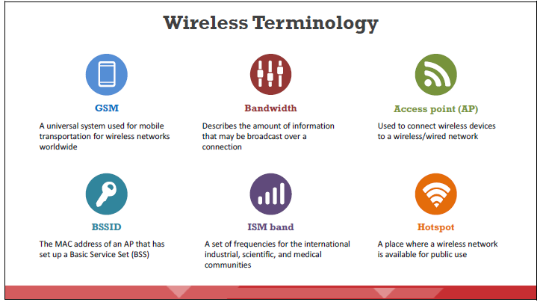
Understand Wireless Terminology
A wireless network is an unbounded data communication system that uses radio-frequency technology to communicate with devices and obtain data.
This network frees the user from complicated and multiple wired connections single electromagnetic (EM) waves to interconnect two individual points without establishing any physical connection
Dr. M Malook Rind Information Security Lecture 12

Slide 5
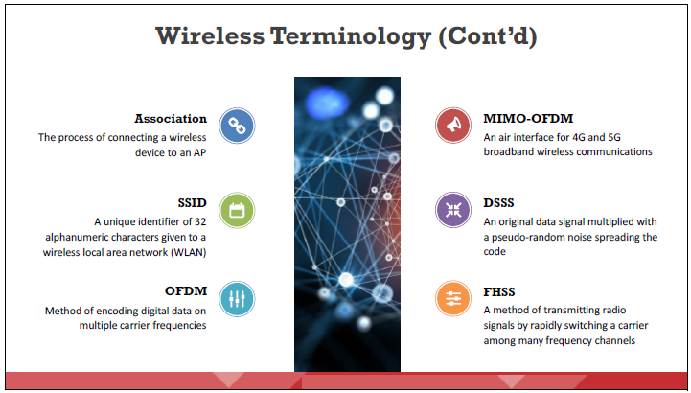
Understand Wireless Terminology
Dr. M Malook Rind Information Security Lecture 12

Slide 6
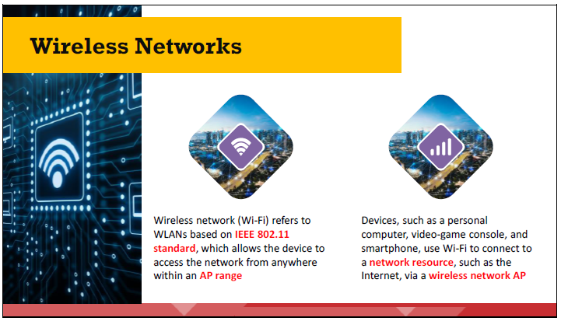
Understand Wireless Terminology
Wi-Fi utilizes numerous techniques such as DSSS, FHSS, infrared (IR), and OFDM to establish a connection between a transmitter and receiver
Dr. M Malook Rind Information Security Lecture 12

Slide 7
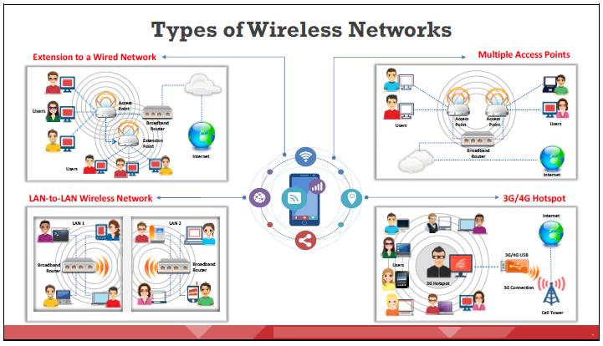
Understand Wireless Terminology
Different types of wireless networks are
Dr. M Malook Rind Information Security Lecture 12

Slide 8
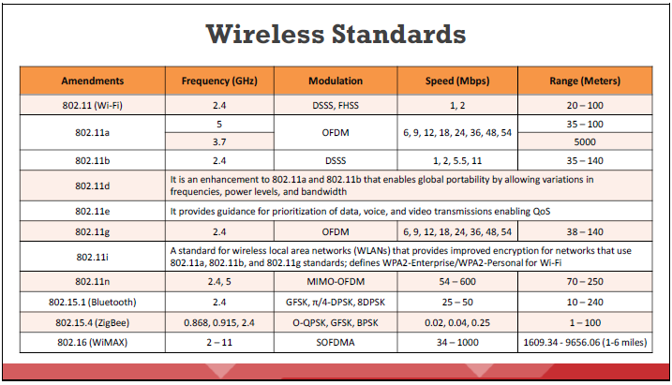
Understand Wireless Terminology
IEEE Standard 802.11 has evolved
Dr. M Malook Rind Information Security Lecture 12

Slide 9
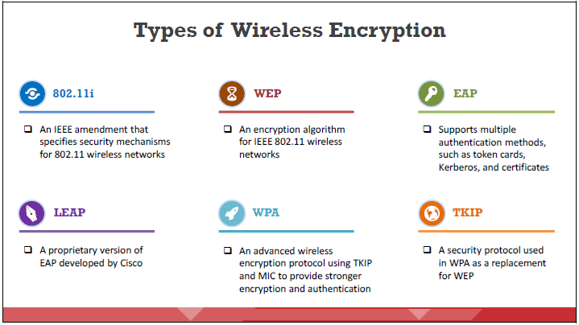
Different Types of Wireless Encryption
A wireless encryption is a process of protecting a wireless network from attackers who attempt to collect sensitive information by breaching the RF traffic.
Various wireless encryption standards Include Wired Equivalent Privacy (WEP), Wi-Fi Protected Access (WPA), WPA2, and WPA3
Dr. M Malook Rind Information Security Lecture 12

Slide 10
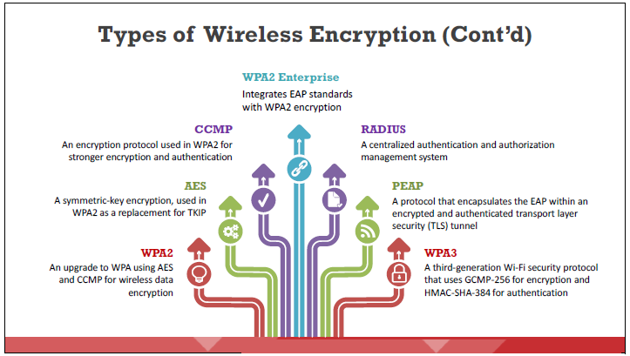
Different Types of Wireless Encryption
Attacks on wireless networks are increasing daily with the increasing use of wireless networks.
The encryption of information before it is transmitted on a wireless network is the most popular method of protecting wireless networks against attackers.
Dr. M Malook Rind Information Security Lecture 12

Slide 11
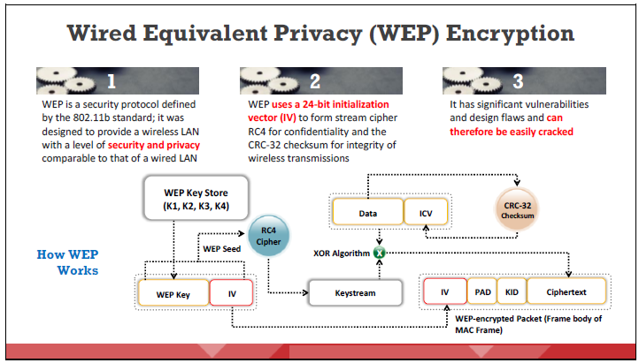
Different Types of Wireless Encryption
Wired Equivalent Privacy (WEP) utilizes an encryption mechanism at the data link layer with the symmetric Rivest Cipher 4 (RC4) encryption algorithm.
WEP was an early attempt to protect wireless networks and is now vulnerable to attacks.
How it Works
CRC-32 checksum is used to calculate a 32-bit integrity check value (ICV) for the data, which, in turn, is added to the data frame.
A 24-bit arbitrary number known as the initialization vector (IV) is added to the WEP key; the WEP key and IV are together called the WEP seed.
The WEP seed is used as the input to the RC4 algorithm to generate a keystream, which is bit-wise XORed with a combination of the data and ICV to produce the encrypted data.
The IV field (IV + PAD + KID) is added to the ciphertext to generate a MAC frame.
Dr. M Malook Rind Information Security Lecture 12

Slide 12
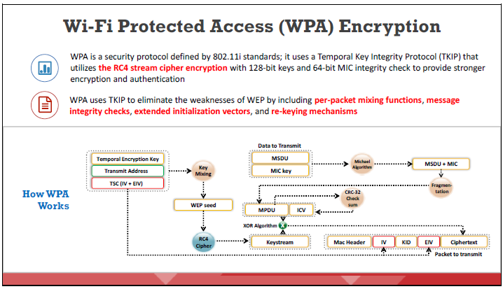
Different Types of Wireless Encryption
WPA has better data encryption security than WEP
Dr. M Malook Rind Information Security Lecture 12

Slide 13
Different Types of Wireless Encryption
How WPA Works
CA TK, transmit address, and TKIP sequence counter (TSC) are used as input to the RC4 algorithm to generate a keystream.
The IV or TK sequence, transmit address or MAC destination address, and TK are combined with a hash function or mixing function to generate a 128-bit and 104-bit key.
This key is then combined with RC4 to produce the keystream, which should be of the same length as the original message.
The MAC service data unit (MSDU) and message integrity check (MIC) are combined using the Michael algorithm.
The combination of MSDU and MIC is fragmented to generate the MAC protocol data unit (MPDU).
A 32-bit ICV is calculated for the MPDU.
The combination of MPDU and ICV is bitwise XORed with the keystream to produce the encrypted data.
The IV is added to the encrypted data to generate the MAC frame.
Dr. M Malook Rind Information Security Lecture 12

Slide 14
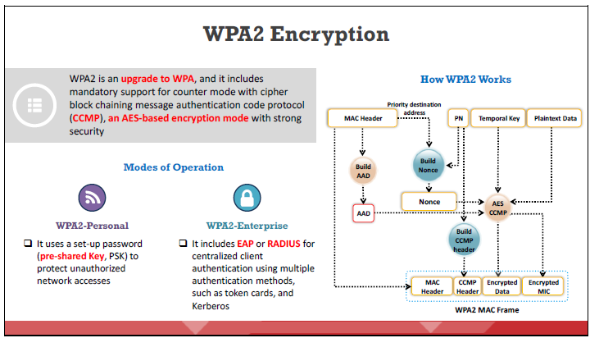
Different Types of Wireless Encryption
WPA2 replaced WPA in 2006 and supports many security features that WPA does not.
Dr. M Malook Rind Information Security Lecture 12

Slide 15
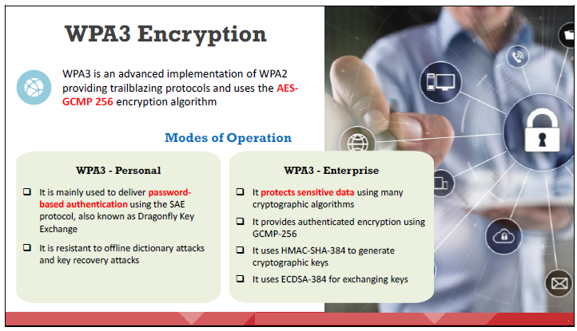
Different Types of Wireless Encryption
Wi-Fi Protected Access 3 (WPA3) was announced by the Wi-Fi Alliance on January 2018.
WPA3 also disallows outdated legacy protocols
Dr. M Malook Rind Information Security Lecture 12

Slide 16
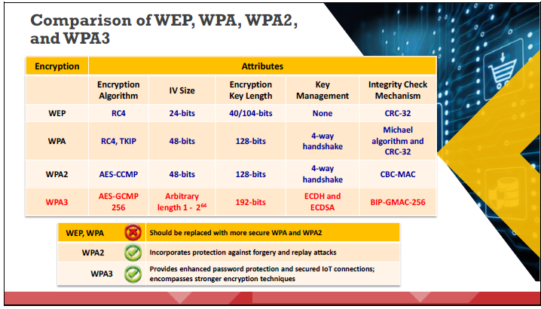
Different Types of Wireless Encryption
Dr. M Malook Rind Information Security Lecture 12

Slide 17
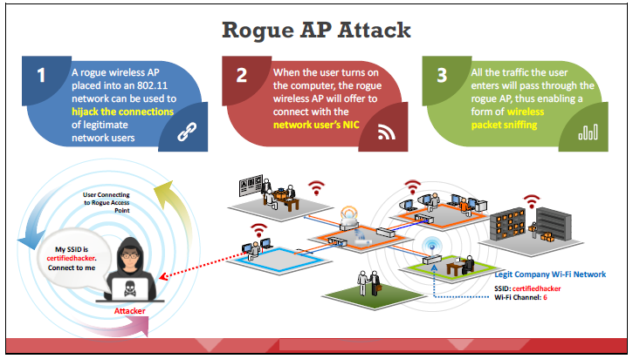
Wireless Network-Specific Attack Techniques
The wireless network can be at risk to various types of attacks.
Dr. M Malook Rind Information Security Lecture 12

Slide 18
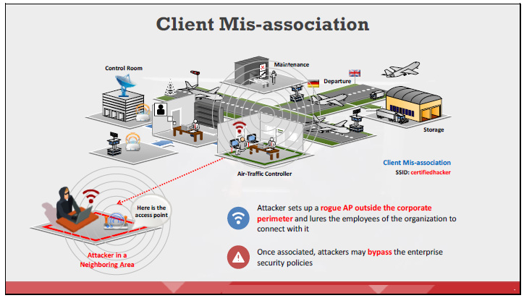
Wireless Network-Specific Attack Techniques
Mis-association is a security flaw that can occur when a network client connects with a neighboring AP.
To perform a client mis-association attack, an attacker sets up a rogue AP outside the corporation’s perimeter. The attacker first learns the SSID of the target wireless network. Using a spoofed SSID, the attacker may send beacons advertising the rogue
AP in order to lure clients to connect. The attacker can use the rogue AP as a channel to bypass enterprise security policies. Once a client connects to the rogue AP, an attacker can retrieve sensitive information such as usernames and passwords by launching MITM, EAP dictionary, or Metasploit attacks to exploit client mis-association.
Dr. M Malook Rind Information Security Lecture 12

Slide 19
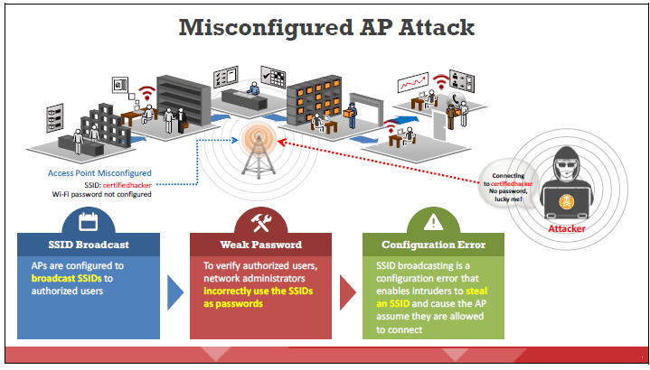
Wireless Network-Specific Attack Techniques
A misconfigured AP can expose an otherwise well-secured network to attacks. Attackers can easily connect to a secured network through misconfigured APs, which continue to function normally after an attacker connects because no alerts will be triggered even if the attacker uses the connection to compromise security.
Dr. M Malook Rind Information Security Lecture 12

Slide 20
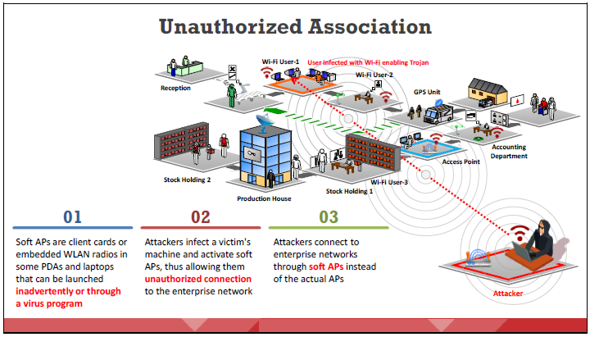
Wireless Network-Specific Attack Techniques
It has two forms: accidental association and malicious association.
An attacker performs malicious association with the help of soft APs instead of corporate APs.
Dr. M Malook Rind Information Security Lecture 12

Slide 21
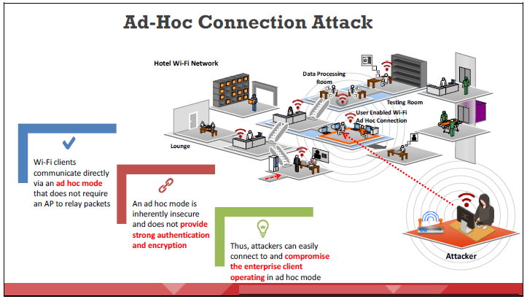
Wireless Network-Specific Attack Techniques
Security threats arise when an attacker forces a network to enable the ad-hoc mode.
The ad-hoc mode is insecure and does not provide strong authentication or encryption.
Thus, an attacker can easily connect to and compromise a client operating in the ad-hoc mode.
Dr. M Malook Rind Information Security Lecture 12

Slide 22
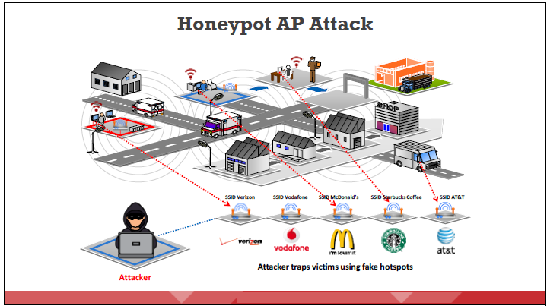
Wireless Network-Specific Attack Techniques
If multiple WLANs co-exist in the same area, a user can connect to any available network. Such areas are vulnerable to attacks. An attacker takes advantage of this behavior of wireless clients by setting up an unauthorized wireless network using a rogue AP. This AP has high-power (high-gain) antennas and uses the same SSID as the target network. Users who regularly connect to multiple WLANs may connect to the rogue AP. Such APs mounted by attackers are called “honeypot” Aps. Sensitive user information such as identity, username, and password may be revealed to the attacker.
Dr. M Malook Rind Information Security Lecture 12

Slide 23
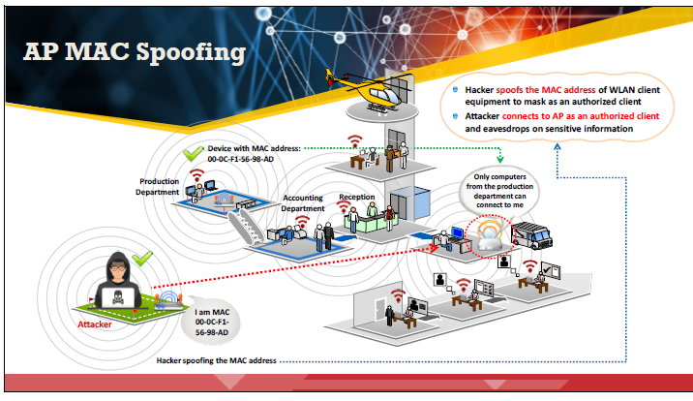
Wireless Network-Specific Attack Techniques
An attacker can spoof the MAC address of the AP by programming a rogue AP to advertise the same identity information as that of the legitimate AP.
An attacker connected to the AP as an authorized client can have full access to the network. This type of attack succeeds when the target wireless network uses MAC filtering to authenticate clients (users).
Dr. M Malook Rind Information Security Lecture 12

Slide 24
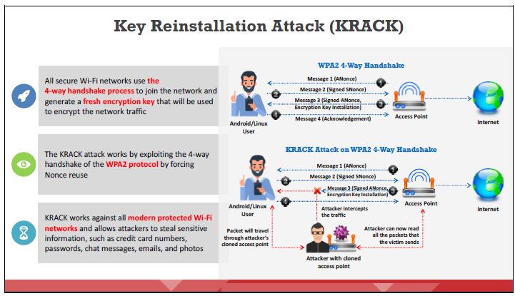
Wireless Network-Specific Attack Techniques
This attack exploits the flaws in the implementation of the four-way handshake process in the WPA2 authentication protocol, which is used to establish a connection between a device and an AP.
Dr. M Malook Rind Information Security Lecture 12

Slide 25
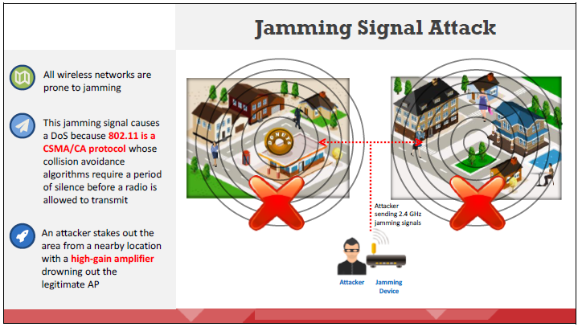
Wireless Network-Specific Attack Techniques
In this type of exploitation, overwhelming volumes of malicious traffic result in a DoS to authorized users, obstructing legitimate traffic. All wireless networks are prone to jamming, and spectrum jamming attacks usually block all communications completely. An attacker uses specialized hardware to perform this kind of attack. The signals generated by jamming devices appear to be noise to the devices on the wireless network, which causes them to hold their transmissions until the signal has subsided, resulting in a DoS.
Dr. M Malook Rind Information Security Lecture 12

Slide 26
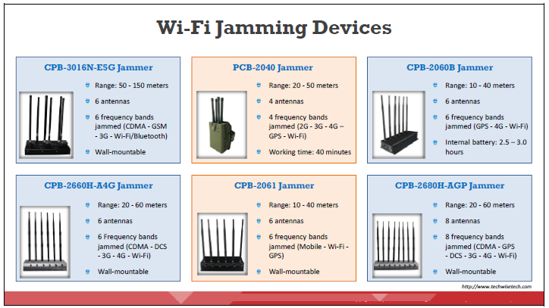
Wireless Network-Specific Attack Techniques
An attacker can jam a wireless network using a Wi-Fi jammer. This device uses the same frequency band as a trusted network.
It causes interference to legitimate signals and temporarily disrupts the network service.
Dr. M Malook Rind Information Security Lecture 12

Slide 27
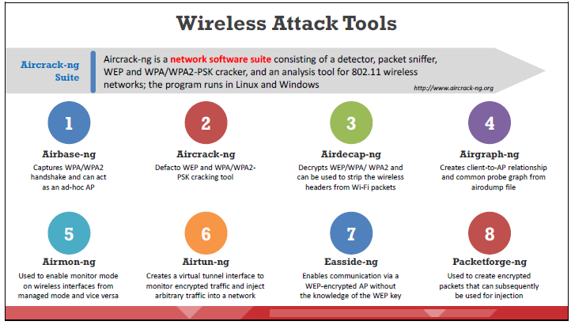
Wireless Network-Specific Attack Techniques
Some of the important wireless attack tools:
Dr. M Malook Rind Information Security Lecture 12

Slide 28
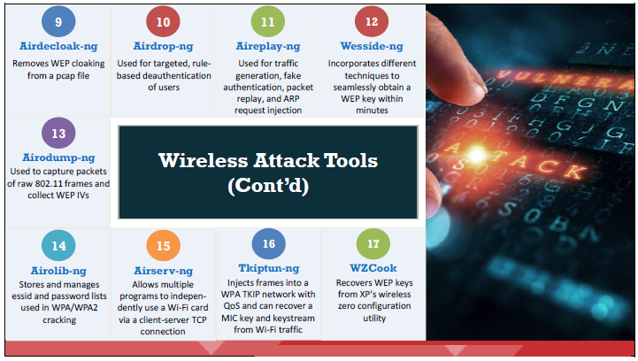
Wireless Network-Specific Attack Techniques
Dr. M Malook Rind Information Security Lecture 12

Slide 29
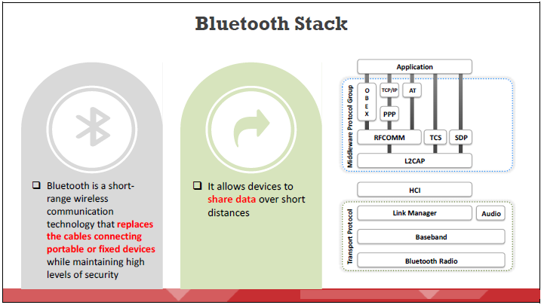
Wireless Network- Bluetooth Attacks
A Bluetooth stack refers to an implementation of the Bluetooth protocol stack.
It allows an inheritance application to work over Bluetooth.
Dr. M Malook Rind Information Security Lecture 12

Slide 30
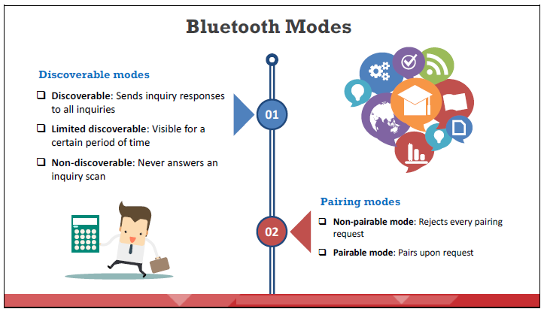
Wireless Network- Bluetooth Attacks
A user can set Bluetooth in the following modes
Dr. M Malook Rind Information Security Lecture 12

Slide 31
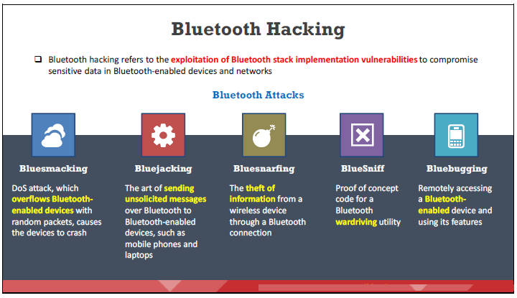
Wireless Network- Bluetooth Attacks
Bluetooth-enabled devices connect and communicate wirelessly through ad-hoc networks known as piconets.
Attackers can gain information by hacking the target Bluetooth-enabled device from another Bluetooth-enabled device.
Dr. M Malook Rind Information Security Lecture 12

Slide 32
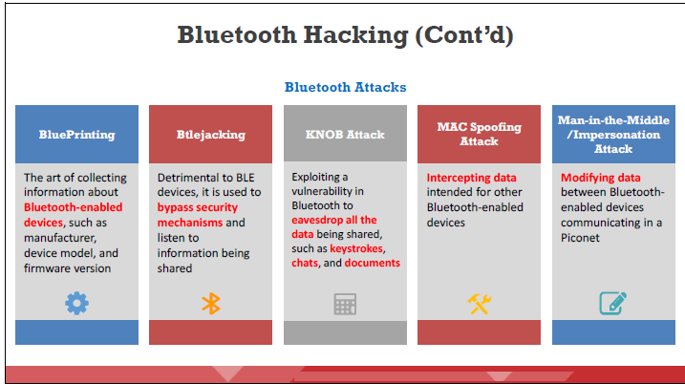
Wireless Network- Bluetooth Attacks
Dr. M Malook Rind Information Security Lecture 12

Slide 33
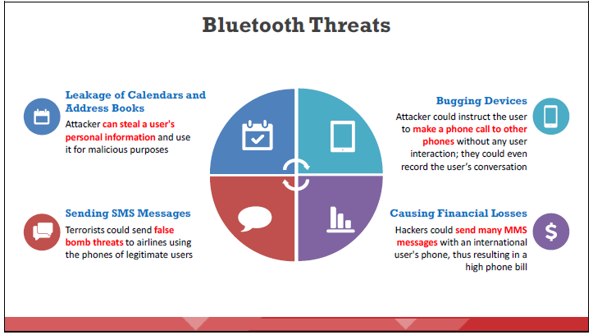
Wireless Network- Bluetooth Attacks
Attackers target vulnerabilities in the security configurations of Bluetooth devices to gain access to confidential information and the network to which they are connected.
Dr. M Malook Rind Information Security Lecture 12

Slide 34
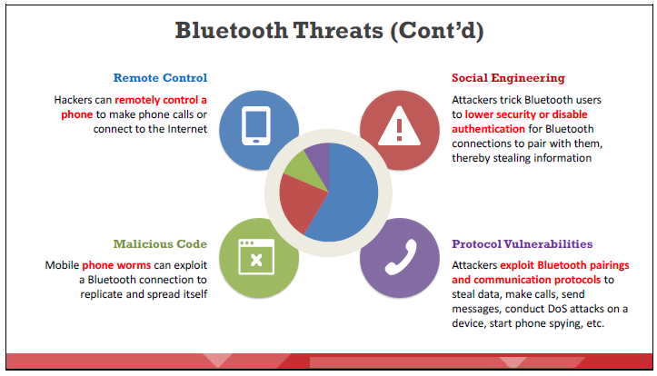
Wireless Network- Bluetooth Attacks
Dr. M Malook Rind Information Security Lecture 12

Slide 35
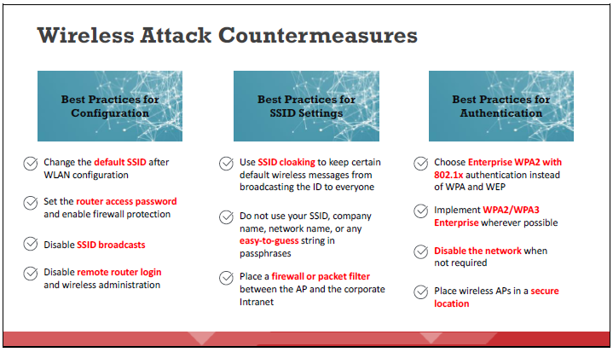
Wireless Network- Wireless Attack Countermeasures
To secure a wireless network, it is important to implement and adopt appropriate countermeasures.
Dr. M Malook Rind Information Security Lecture 12

Slide 36
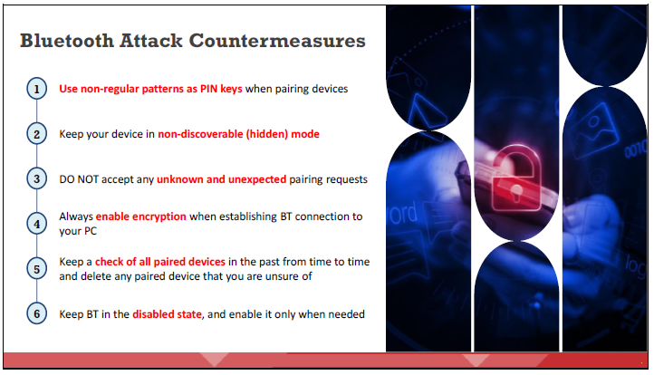
Wireless Network- Wireless Attack Countermeasures
Following are some countermeasures to defend against Bluetooth hacking
Dr. M Malook Rind Information Security Lecture 12

Slide 37
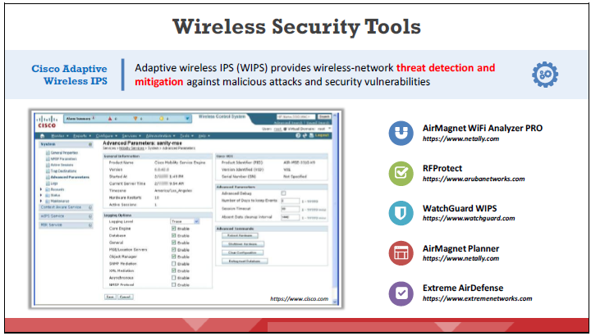
Wireless Network- Wireless Attack Countermeasures
Dr. M Malook Rind Information Security Lecture 12

Slide 38
Thanks
Dr. M Malook Rind Information Security Lecture 12

